Slide 1
15.763 Administrative Issues
(completely optional) student meetings
  Signup at https://bit.ly/15763signup
  If no feasible time, shoot me a note to find another time
(completely optional) recitation Friday 11:30-12:30
BigFig part 1 due Monday
  It should not be super onerous
SteelCo due Wednesday, Wood Pellet due following Wednesday

Slide 2
OPT Game Results
2022 performance
  24 users went bankrupt
  20 users ended with less than $1500 cash on hand
  27 users made money (i.e., ended with > $1500)
    Fabio and Taylor ending with > $4,000 is amazing
Sean’s ~2005 performance
  Game was six weeks; I earned maximum possible (~ 7000)
  Then I stopped playing when I had earned $10M
    How did I do this?
      The difference between users and hackers; why you need dedicated QA resources

Slide 3
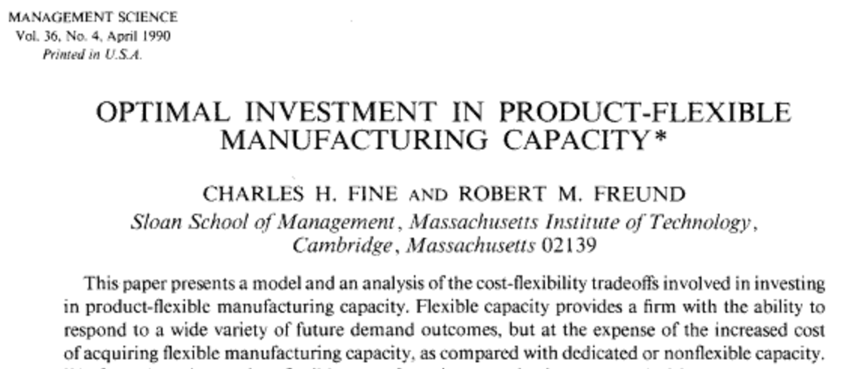
A Trip Down Memory Lane – Sean’s Comprehensive Exam
Comprehensive exam question: Is the Theorem 1 correct?
Four students take exam. Sean is the only one that proves Theorem 1 is incorrect. Sean is the only one that fails the comprehensive exam. What happened?
We write for two reasons: to educate others and to convince ourselves we understand what we think we understnad

Slide 4
OPT Game Debrief
Which machine Is the bottleneck?
  How do you know? (you possess knowledge)
  How do you convince others? (you possess wisdom)
What was your strategy?
Can we write a simple LP to solve OPT?
What is unrealistic about the game?
Summary

Slide 5
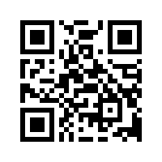
Please complete the end-of-class two-question survey
What is your main learning?
What is your unanswered question?
https://bit.ly/15763end

